Slide 1
Remaking Machine Learning
Combining Methods of Making Machine Learning Models Resilient to Adversarial Attacks

Slide 2
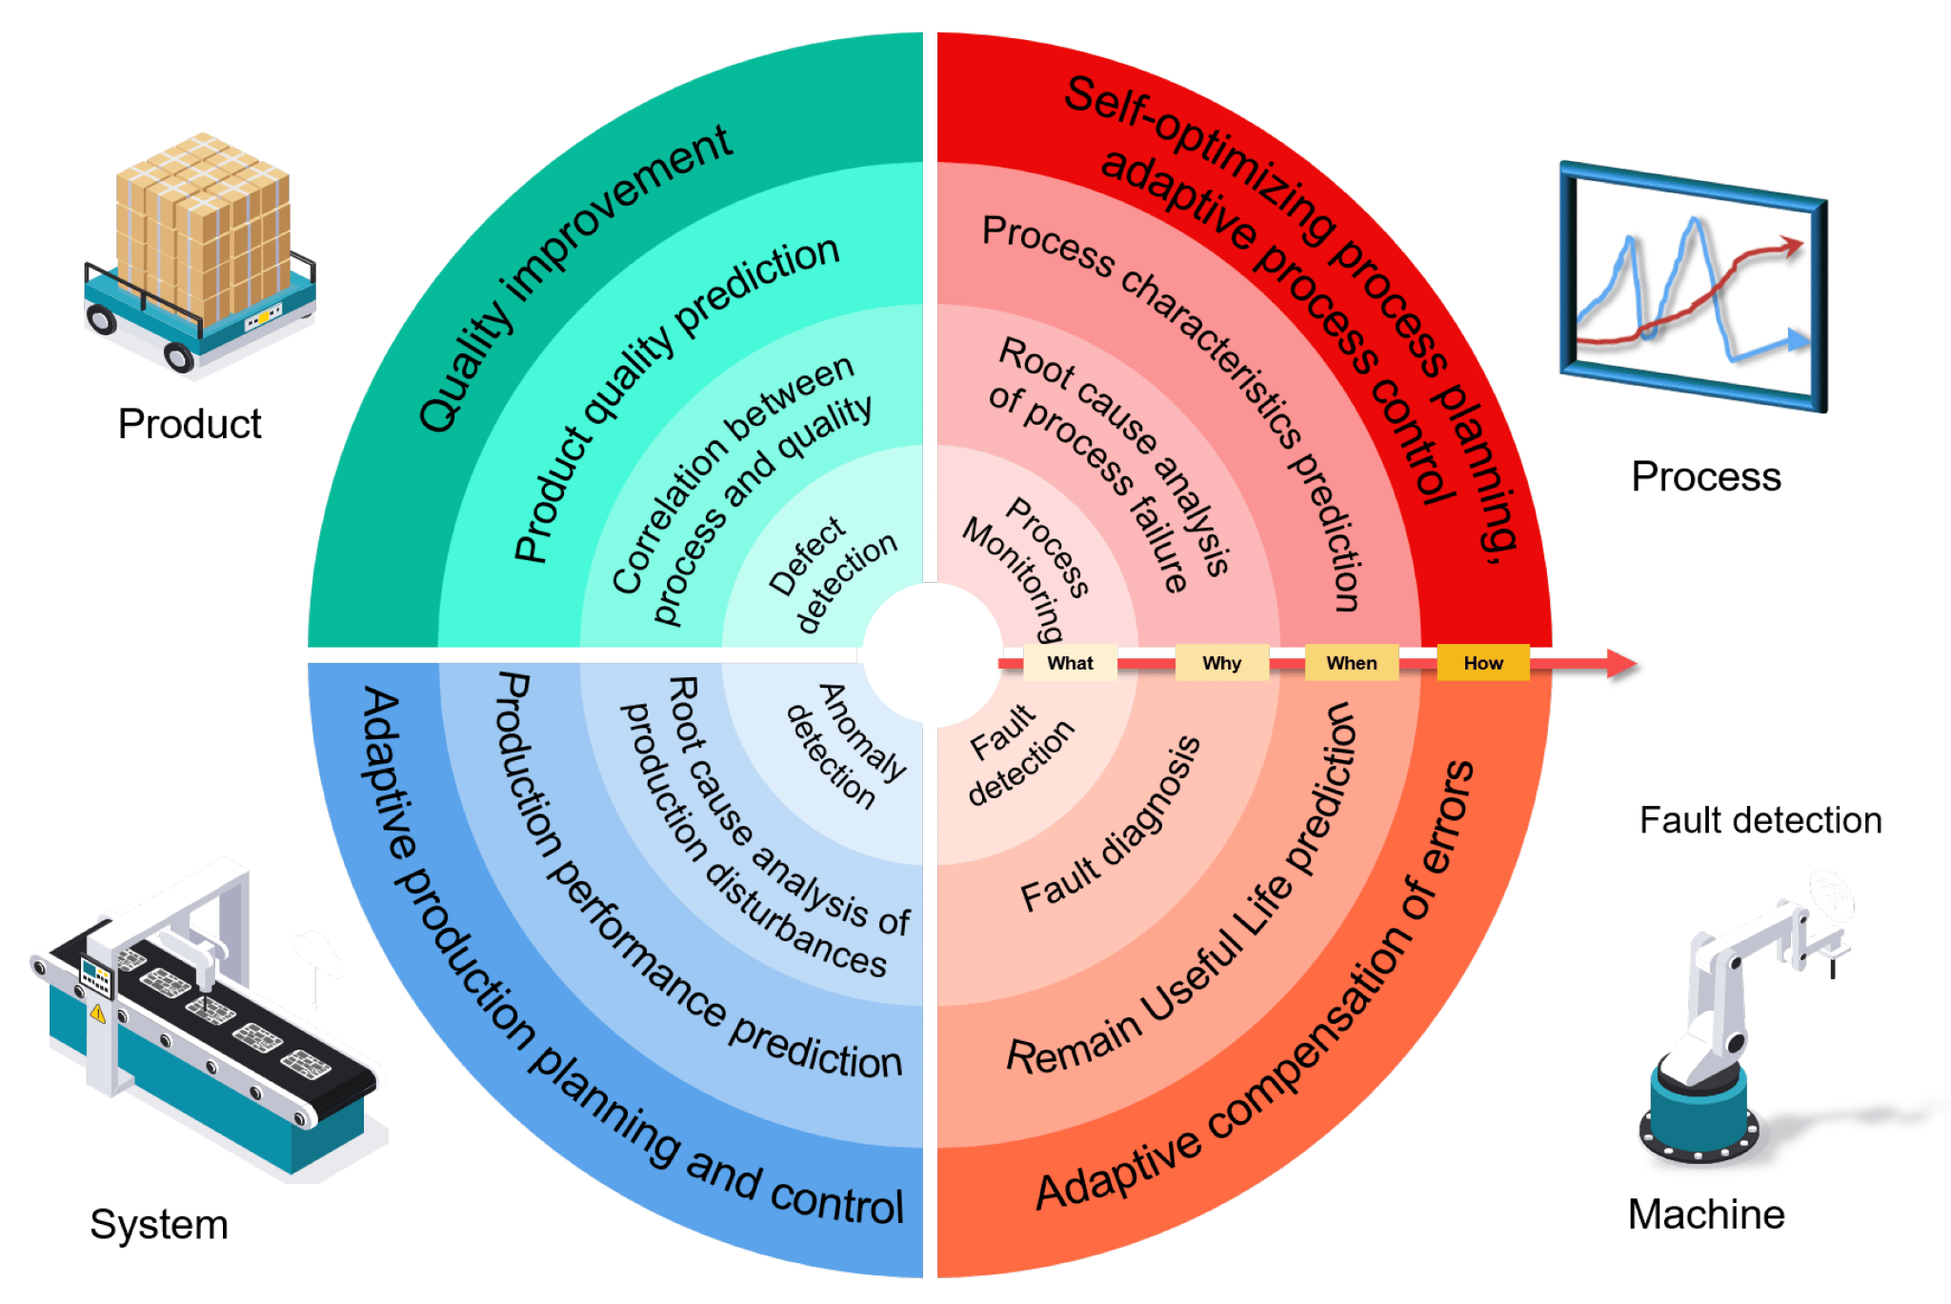
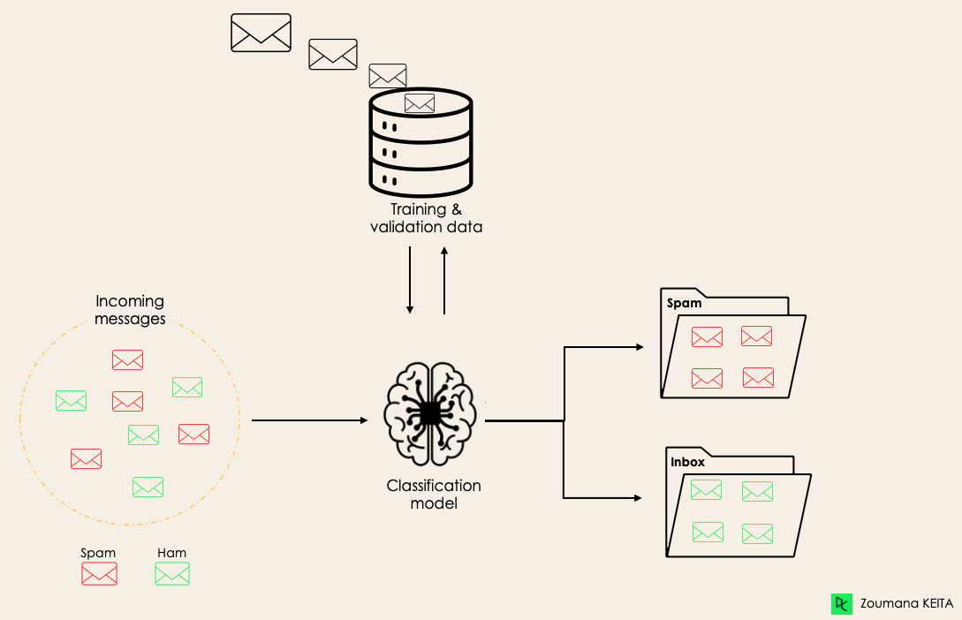
Introduction to Machine Learning

Slide 3
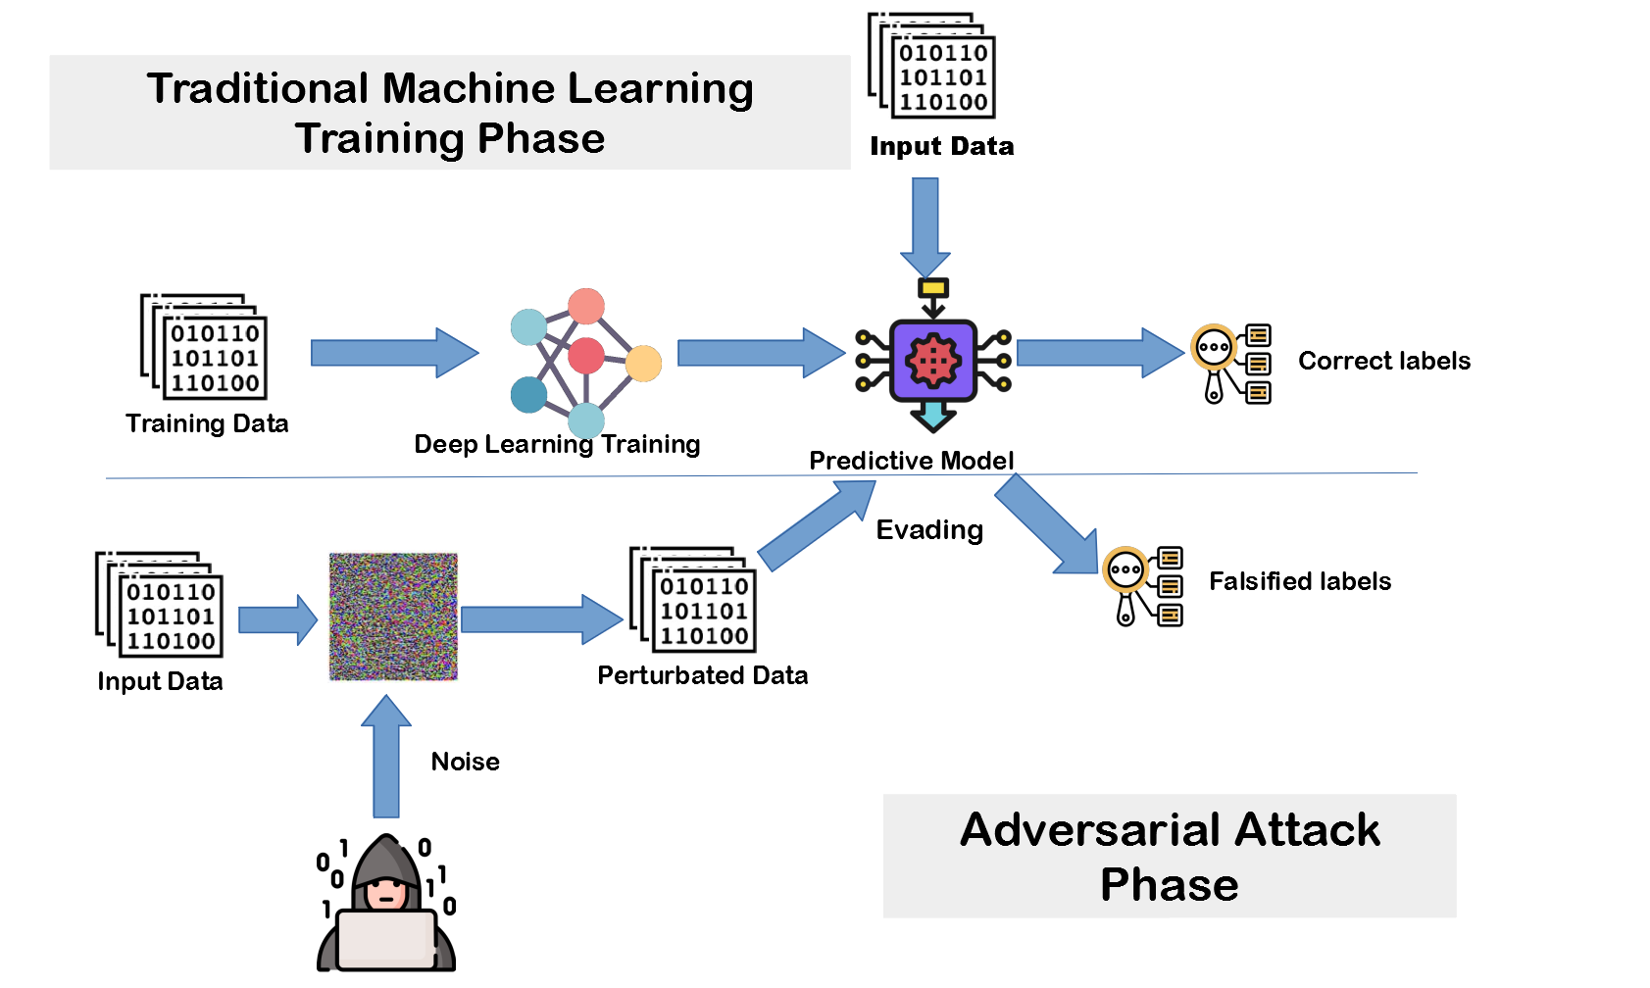
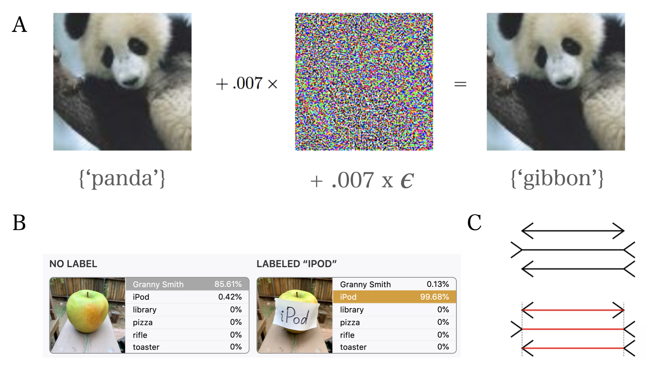
Adversarial Attacks

Slide 4
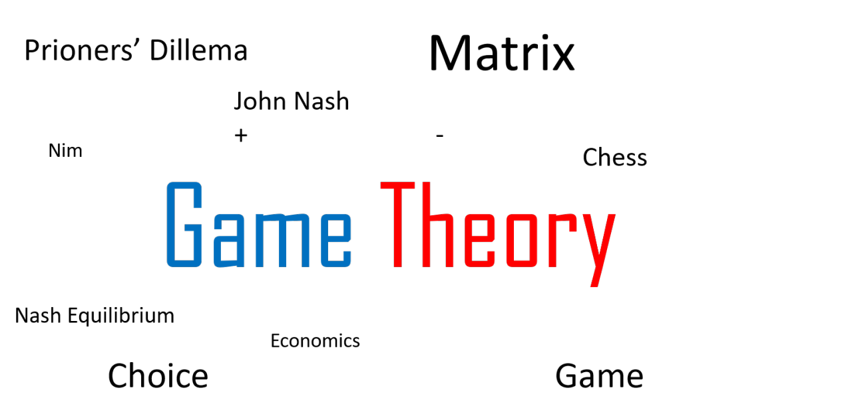
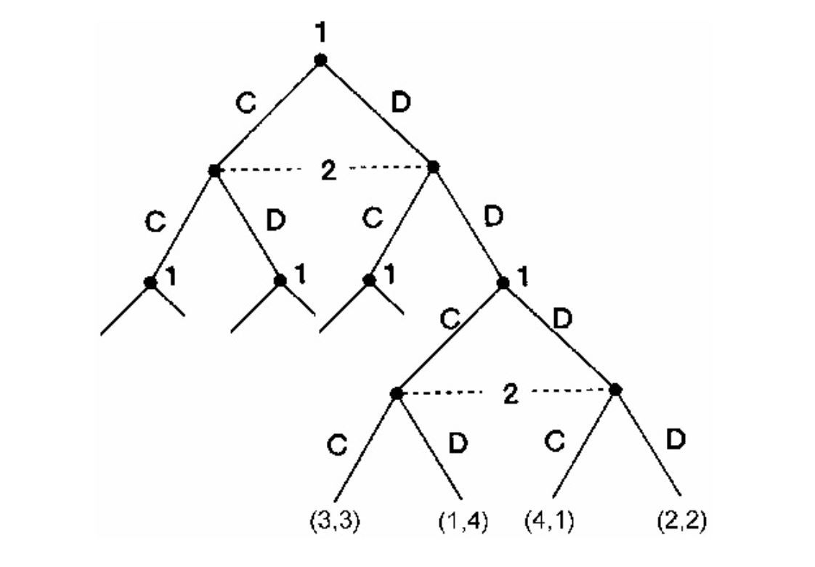
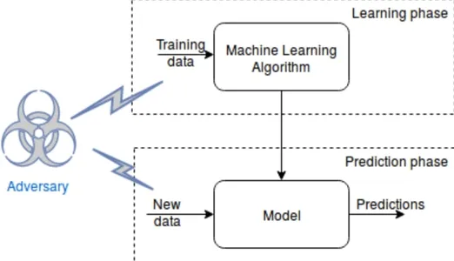
Game Theory and ML
(Dasgupta & Collins, 2019)

Slide 5
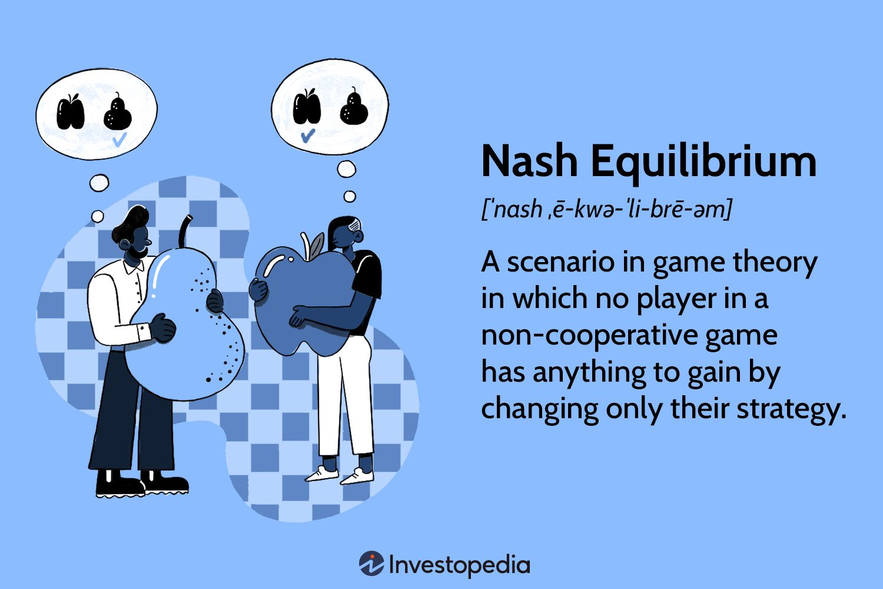
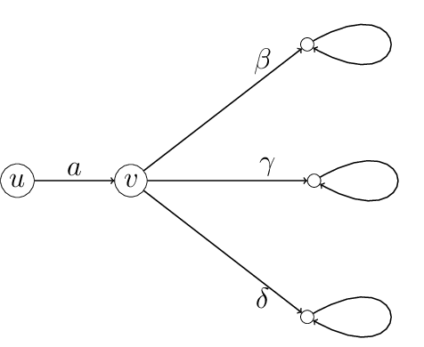
Finding Mixed Nash Equilibrium (MNE)
(Robey et al., 2023)

Slide 6
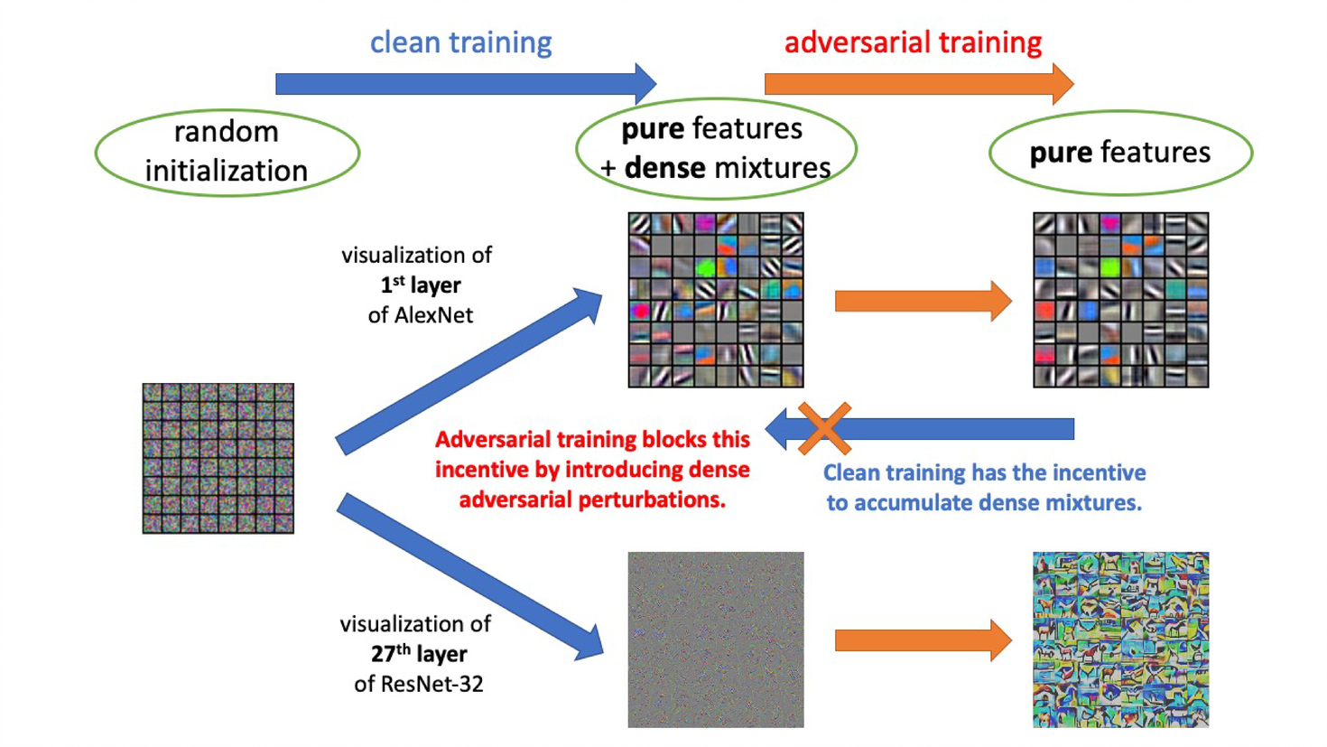
Modifying Training Data
(Ren et al., 2020)

Slide 7
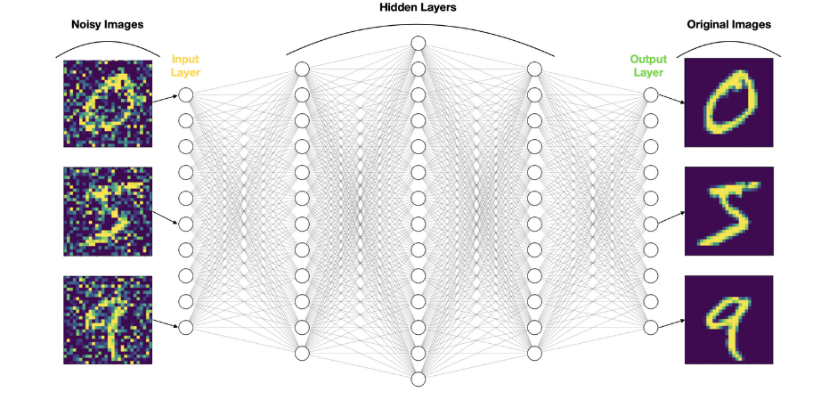
Modifying Test Data
(Sahay et al., 2018)

Slide 8
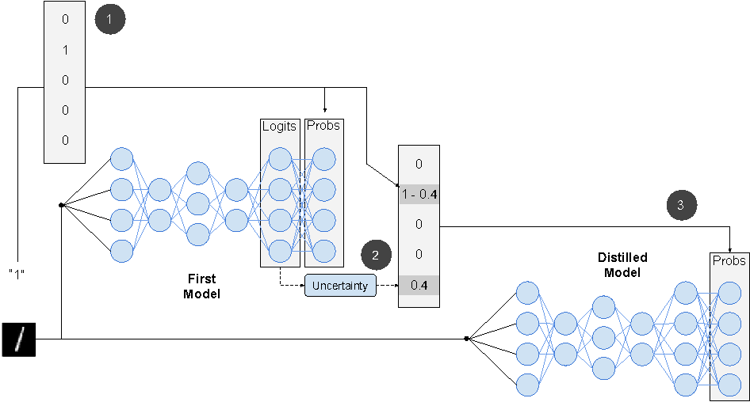
Modifying Training Algorithm
(Papernot et al., 2015)

Slide 9
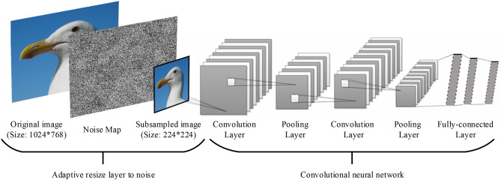
Modifying Training Algorithm
(Liu et al., 2017)

Slide 10
Methods Combined and Tested
Modifying Training Data
FGSM Adversarial Training
PGD Adversarial Training
Modifying Test Data
FGSM Adversarial Denoising
PGD Adversarial Denoising
Modifying Training Algorithm
Defensive Distillation
Random Self Ensemble
Test on clean data, FGSM-modified data, and PGD-modified data

Slide 11
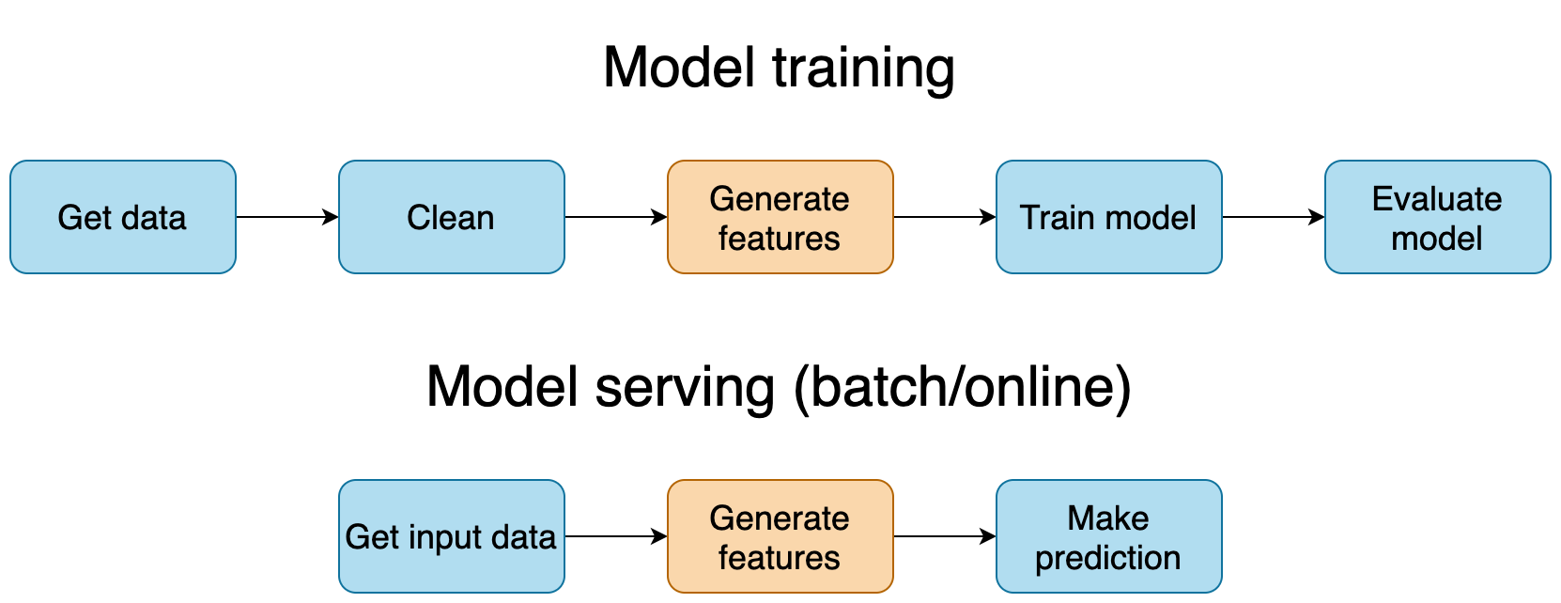
Clean Model Training

Slide 12
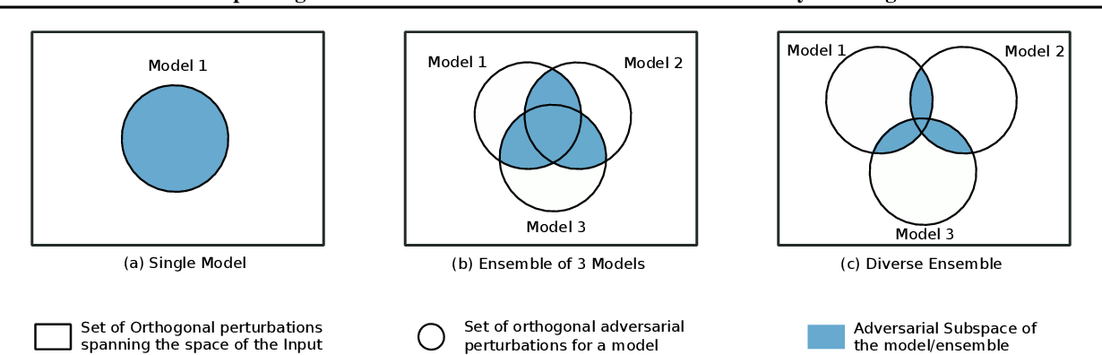
Orthogonal Strategies

Slide 13
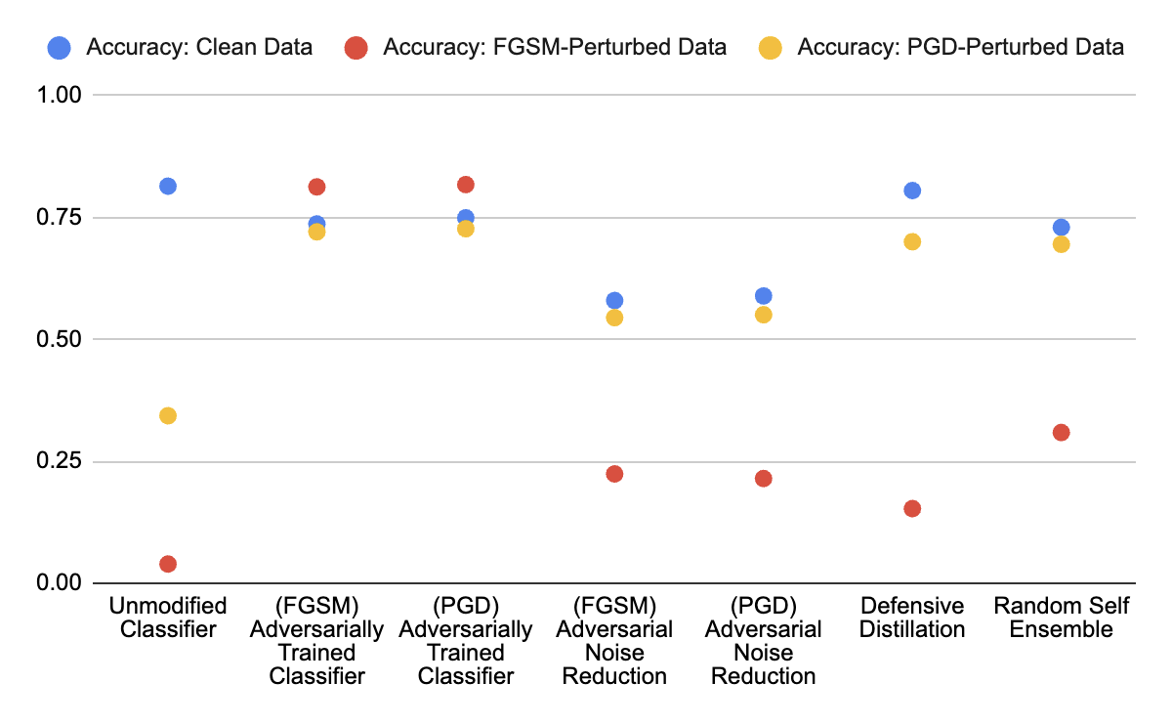
Results (Individual Methods)

Slide 14
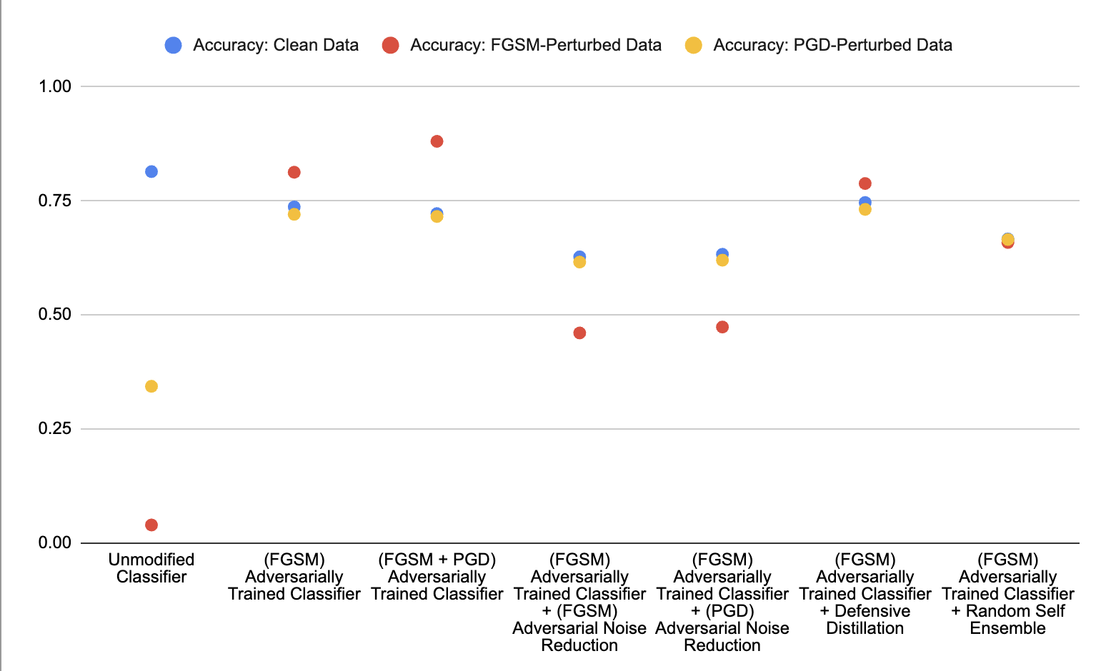
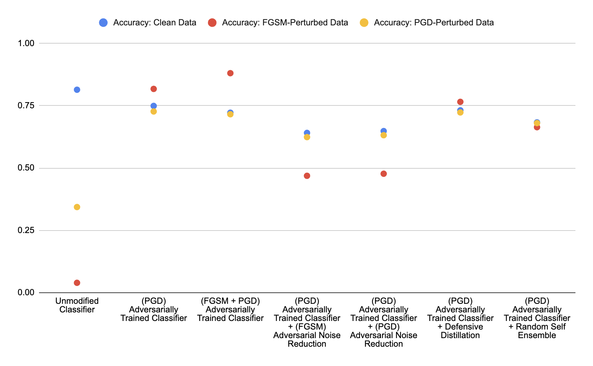
Results (Modifying Training Data)

Slide 15
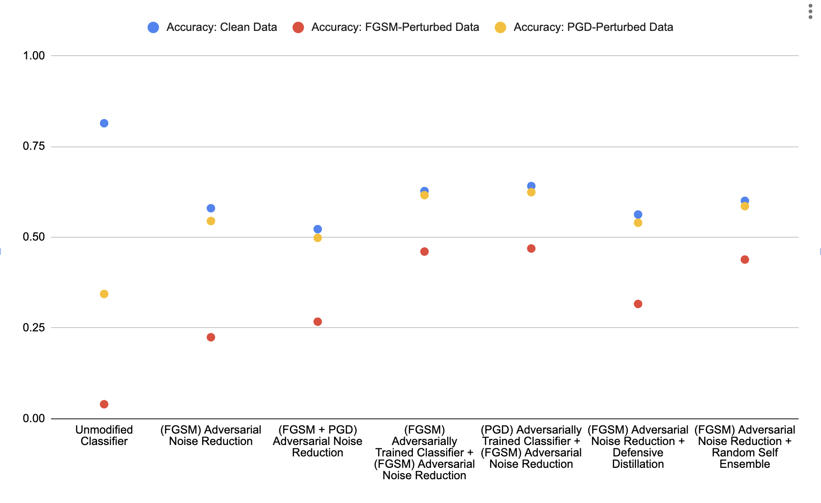
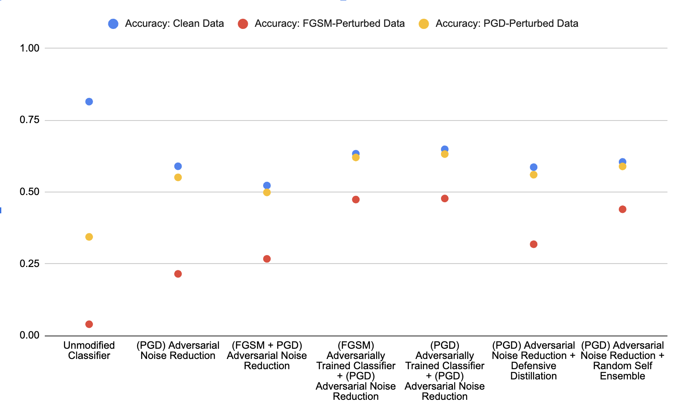
Results (Modifying Test Data)

Slide 16
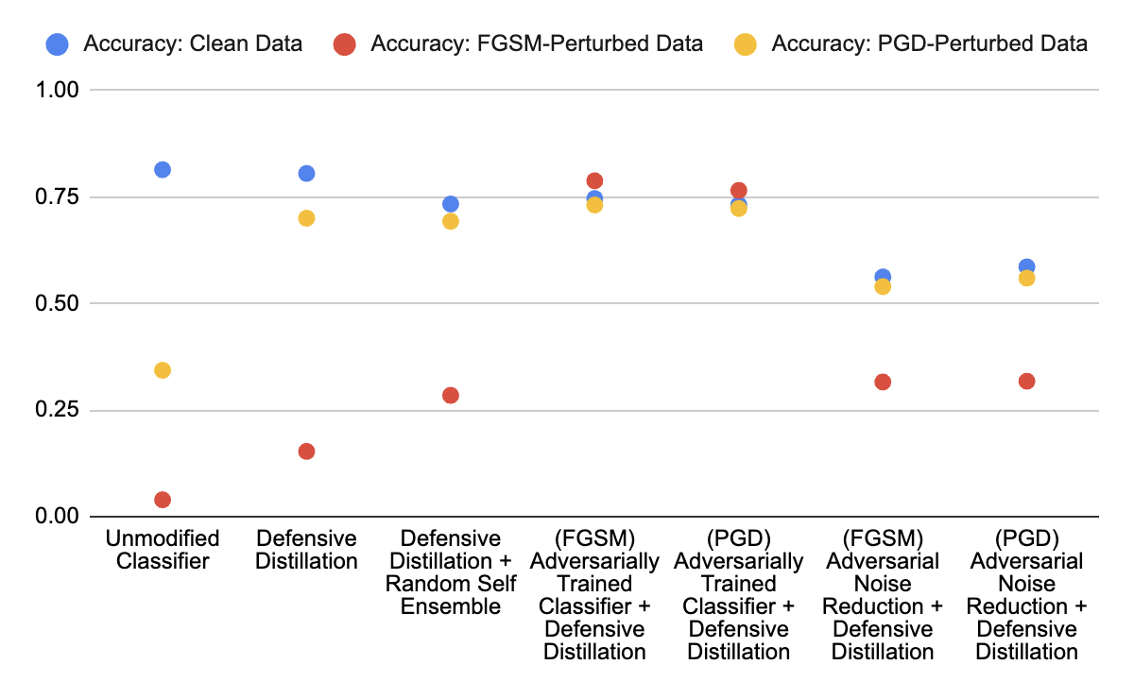
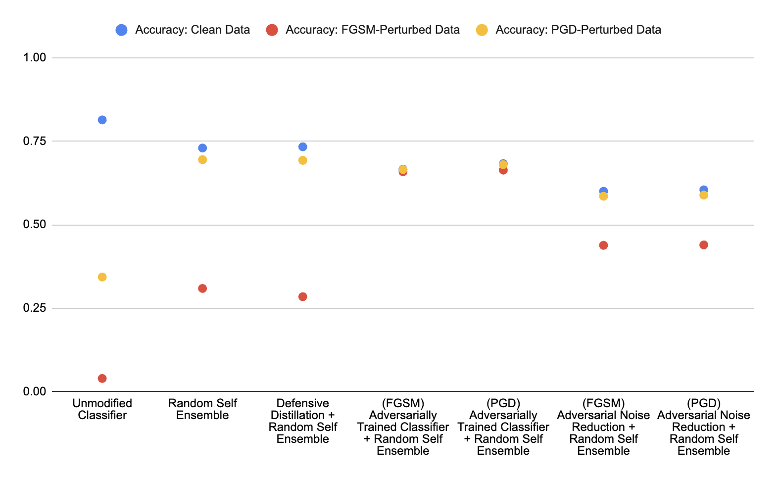
Results (Modifying Training Algorithm)

Slide 17
Conclusion
Although individual strategies may modify classifiers in different ways, orthogonal combinations decrease the effectiveness of “optimal” strategies (closest to MNE).
Adversarial Training is closest to MNE
Strategies with different accuracies in clean/adversarial data can be combined to form a new strategy closer to MNE

Slide 18

Implications
Non-optimal strategies can be combined
Further research must be done on the interactions of optimal strategies

Slide 19
References
Dasgupta, P., & Collins, J. B. (2019). A survey of game theoretic approaches for adversarial machine learning in cybersecurity tasks. AI Mag., 40, 31–43.
Liu, X., Cheng, M., Zhang, H., & Hsieh, C.-J. (2018). Towards robust neural networks via random self-ensemble. Computer Vision – ECCV 2018, 381–397.
Papernot, N., Mcdaniel, P., Wu, X., Jha, S., & Swami, A. (2015). Distillation as a defense to adversarial perturbations against deep neural networks. 2016 IEEE Symposium on Security and Privacy (SP), 582–597.
Ren, K., Zheng, T., Qin, Z., & Liu, X. (2020). Adversarial attacks and defenses in deep learning. Engineering.
Robey, A., Latorre, F., Pappas, G., Hassani, H., & Cevher, V. (2023). Adversarial training should be cast as a non-zero-sum game. ArXiv, abs/2306.11035.
Sahay, R., Mahfuz, R., & Gamal, A. E. (2018). Combatting adversarial attacks through denoising and dimensionality reduction: A cascaded autoencoder approach. 2019 53rd Annual Conference on Information Sciences and Systems (CISS), 1–6.

